Slide 1

Political theories-2
Hasan Muhammad Baniamin

Slide 2
Enlightenment theorist

Slide 3
Thomas Hobbes
Thomas Hobbes- an English thinker, wrote a book ‘Leviathan’
Man in the state of nature was in perpetual conflict with his neighbors on account of his essentially selfish nature. Every man was an enemy to every other man.
All being almost equally “ selfish, self-seeking, cunning, egoistic, brutal and aggressive”.
Thus, men in the state of nature were hungry wolves each ready to pounce on the other with all its ferocity.
Since the conditions in the state of nature were intolerable and men longed for peace, the people entered into a kind of social contract to ensure for themselves security and certainty of life and property.
By mutual agreement they decided to surrender their natural rights into the hands a few or one with authority to command.

Slide 4
John Locke
John Locke, another English political philosopher.
He believed that man in the state of nature was enjoying an ideal liberty, free from all sorts of rules and regulations. The state of nature was a state of “peace , goodwill, mutual assistance and preservation”.
But there was no recognized system of law and justice. Hence his peaceful life was often upset by the ‘corruption and viciousness of degenerate men’.
In order to escape from this and to gain certainty and security men made a contract to enter into civil society or the state. This contract Locke called ‘social contract’.

Slide 5
Jean Jacques Rousseau
J. J. Rousseau- the Freanch writer of the 18th century who wrote the famous book “ The Social Contract’ .
He wrote that man in the state of nature was a ‘noble savage’ who led a life of ‘ primitive simplicity and idyllic happiness’.
He was independent, contented, self-sufficient, healthy, fearless and good.
But these conditions did not last long. Population increased and reason was dawned. Simplicity and idyllic happiness disappeared. Families were established, institution of property emerged and human equity was ended. Man began to think in terms of ‘mine’ and ‘thine’.
When equality and happiness of the state was lost, war, murder, conflicts, wretchedness, etc. became the order of the day.
The escape from this was found in the formation of a civil society. Natural freedom gave place to civil freedom by social contract.

Slide 6
Contemporary theorist

Slide 7
John Rawls-A Theory of Justice

Slide 8
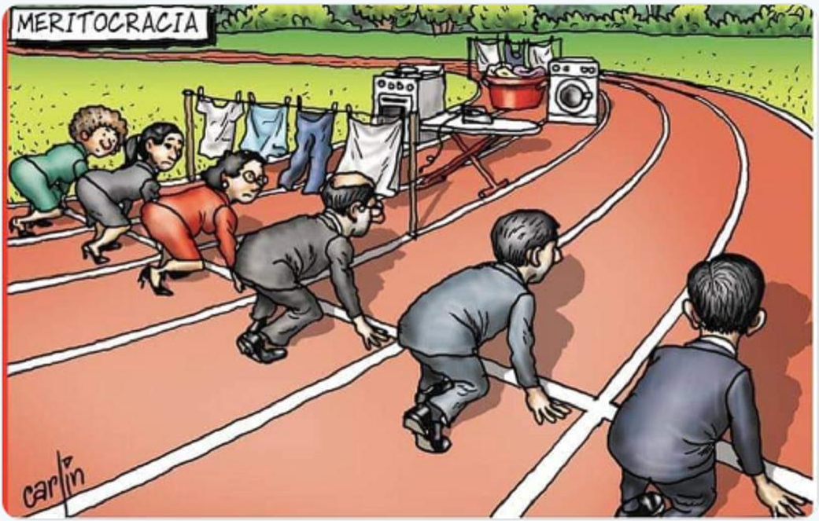
John Rawls-A Theory of Justice

Slide 9
John Rawls-A Theory of Justice
John Rawls belongs to the social contract tradition, although he takes a different view from that of previous thinkers.
Specifically, Rawls develops what he claims are principles of justice through the use of an artificial device he calls the Original position;
Here, everyone decides principles of justice from behind a veil of ignorance.

Slide 10
John Rawls-A Theory of Justice
This "veil" is one that essentially blinds people to all facts about themselves so they cannot tailor principles to their own advantage.
According to Rawls, ignorance of these details about oneself will lead to principles that are fair to all.
If an individual does not know how he will end up in his own conceived society, he is likely not going to privilege any one class of people, but rather develop a scheme of justice that treats all fairly.

Slide 11
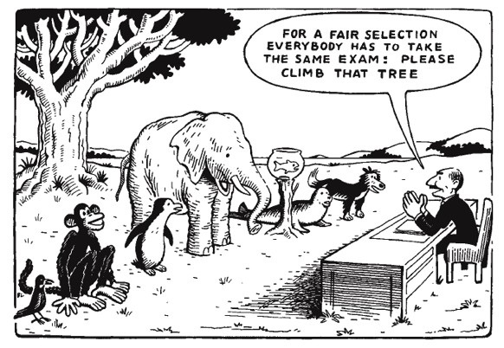
John Rawls-A Theory of Justice

Slide 12
E-Governance Model
E-governance can be defined as the use of ICTs for effective and efficient delivery of government services to citizens and businesses (UN, 2019).
Three main components of E-governance:
  Government-to-Government(G2G)
  Government-to-Citizens (G2C)
  Government-to-Business (G2B)

Slide 13
E-governance
E-governance = E-government (G2G)+ E-democracy (G2C & G2B)
E-government refers to getting internal government operations on the Internet with interactive forms and payment processes to simplify and improve government and the business aspects of governance.
E-democracy allows and encourage interaction between actors, such as government and citizens or government and businesses.

Slide 14
Some benefits
Increases Government Efficiency
Cuts Down Costs to Society
Save Time
Increase Transparency and reduce corruption
Power to the People
Better Relation with Private Sector

Slide 15
E-democracy mechanisms
One way communication- communication from government to citizens
Two way communication- interaction between government and citizens
Active participation- direct contribution by different stakeholders like citizens, NGOs and business
E-democracy =
E-information
E-consultation
E-participation

Slide 16
E-participation and open data
Two types of open data:
  Government generated: Open government data (OGD)
  Citizen generated: Open citizen data (OCD)

Slide 17
Government generated: Open government data (OGD)
OGD may be related to diverse sectors such as tourism, business, education, science and technology, agriculture, health and others.

Slide 18
Citizen generated: Open citizen data (OCD)
Examples:
  ImproveTheNeighborhood in Netherlands: Applications in the Netherlands through which citizens can report problems in public space (Meijer & Potjer, 2018).
  Wheelmap in Germany: Crowdsourced online map that provides information on wheelchair-accessibility of places and routes (Meijer & Potjer, 2018).
  MafiaMaps in Italy: Crowdsourced online map that collects information on past and present mafia activity in Italy (Meijer & Potjer, 2018).

Slide 19
New challenges
Fake news, bot, privacy and surveillance, cyber crime and hacking, malware and virus
Text mining and big data analysis, network based analysis.

Slide 20
Digital Cage
Digitalised civil registries can turn into a ‘digital cage’ if their design does not allow for street-level discretion and correction of errors (Peeters & Widlak, 2018).
  Case study: Esther’ freelancing as motivational speaker and residency registration

Slide 21
Suggested readings
Political Science - An Introduction [Michael G. Roskin, Robert L. Cord, James A. Medeiros, Walter S. Jones] [2016] ;pp 23-24.
Stanford Encyclopedia of Philosophy; link: https://plato.stanford.edu/entries/rawls/
Agarwal, R. C. (2014). Political Theory: Principles of Political Science (New Delhi: S. Chand and Company Limited). (Chapter 22).

Slide 22
Q?

